Slide 1
Lane Line Detection for Autonomous Vehicles
Introduction
Authors -
Manish Sharma, Anwesh Badapanda, Sunisth Kumar, Daksh Jain, Karthikeyan Rathore

Slide 2
Introduction
Lane lines are designed for humans to follow while driving. In the same way, an autonomous driving system uses lane lines to steer the vehicle accordingly and follow the road track in the correct orientation.
Lane Line detection includes localization of the road, the determination of the relative position between vehicle and road, and the analysis of the vehicles heading direction.
Lane detection is a difficult problem because of the varying road conditions that one can encounter while driving.

Slide 3
Introduction
Safety is the main objective of all the road lane detection systems due to the reason is that most of the vehicle road accident happens because of the driver miss leading of the vehicle path.
India, ranks 1st in the number of road accident deaths across the 199 countries reported in the World Road Statistics, 2018 followed by China and US. As per the WHO Global Report on Road Safety 2018, India accounts for almost 11% of the accident related deaths in the World.

Slide 4
Introduction
In this Project we are building one of the components of the autonomous driving system (ADS) that is lane line detection on the road.
Our main intend behind this project, was to build a system which alerts (BEEP Sound) the driver, when he is not in lane.
Therefore, this system will provide a means of warning to the driver in case of any danger and has the potential to save a considerable number of lives.

Slide 5
Environmental variables
Roads can be marked by well-defined solid lines, segmented lines, circular reflectors, physical barriers, or even nothing at all.
The road surface can be comprised of light or dark pavements or combinations.
Various types of markings and shadowing, weather conditions, and time of day can have a great impact on the visibility of the road surface.
All these circumstances must be efficiently handled in order to achieve an accurate vision system.

Slide 6
ideas/methods
To solve this particular problem, there are various algorithms and systems such as LOIS algorithm, Hough Transform, sliding window polynomial fitting, Three-feature based automatic lane detection algorithm (TFALDA) etc.
Hough Transform is more preferred for straight lane lines.
Sliding window polynomial fitting is much better than Hough transform for curved lane lines.
Out of all these algorithms, we have applied Hough Transformation because we were more focused on straight lane lines.

Slide 7
Hough Transform Method (Explain)

Slide 8
Hough Transform Method (Example)

Slide 9
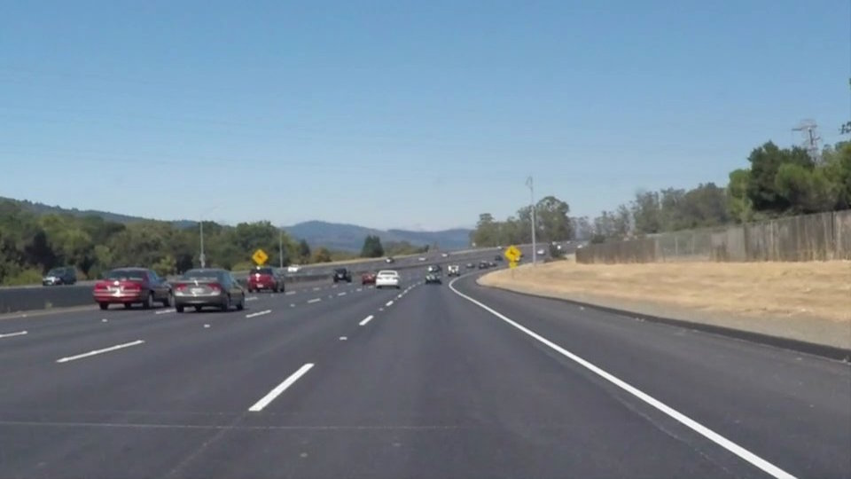
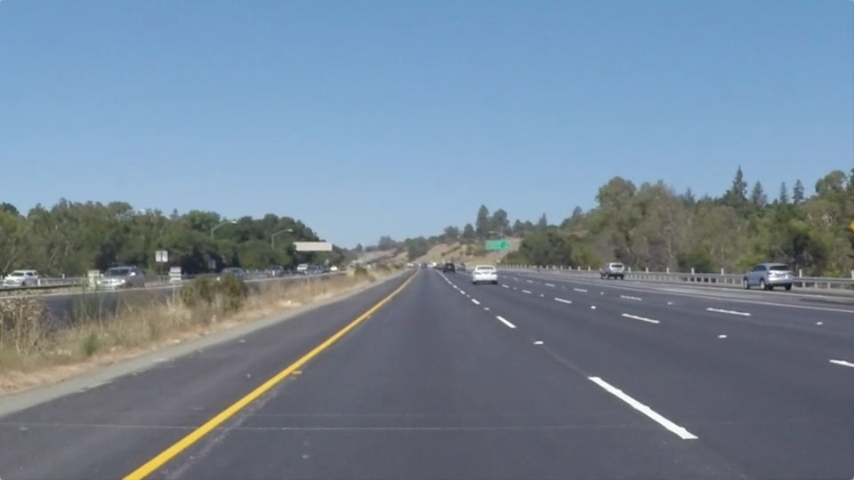
Dataset
All the images in our dataset is 540x960 RGB images.
For dash cam footage we are capturing each frame per second & applying our algorithm pipeline to each image frame.
White Lane Lines
Yellow Lane Lines

Slide 10
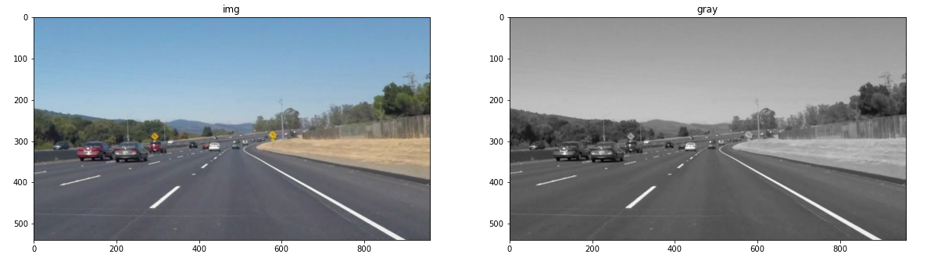
image preprocessing (White Lane Lines)
In our dataset, the colour of surface of the road was changing from one region to another due to factors such as: shadows, different age or style of the road.
To remove this problem we converted the images to grayscale first, meaning converting 24bit, 3 channel colour image to 8bit , 1 channel image.
gray: cv2.cvtColor(img , cv2.COLOR_RGB2GRAY)

Slide 11
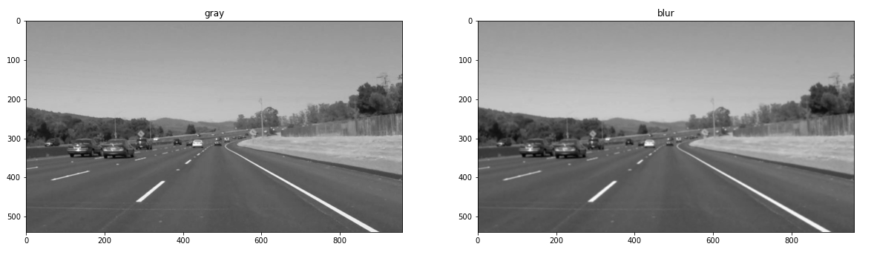
image preprocessing
Noise Reduction
Noise in our image will impact our edge detection.
Gaussian Blur: cv2.GaussianBlur(gray, (5, 5), 0), kernel size=5

Slide 12
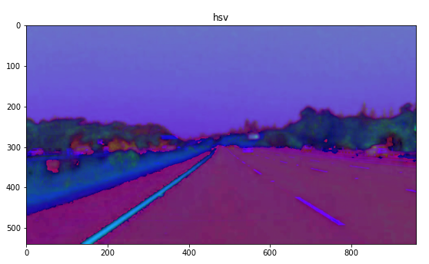
image preprocessing (Yellow Lane Lines)
HSV (Hue, Saturation, Value) useful in segmenting objects in image based on its color.
Since colors in the RGB colorspace are coded using the three channels, it is more difficult to segment an object in the image based on its color.
hsv = cv2.cvtColor(img, cv2.COLOR_BGR2HSV)

Slide 13
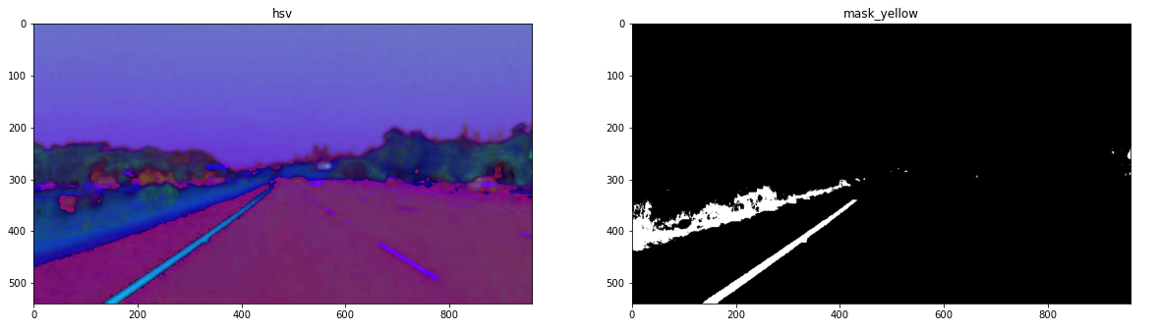
image preprocessing
To extract Yellow color, lower threshold value was (15, 60, 20) (H, S, V) and upper was (25, 255, 255).
mask_yellow = cv2.inRange(hsv, (15,60,20), (25, 255, 255))

Slide 14
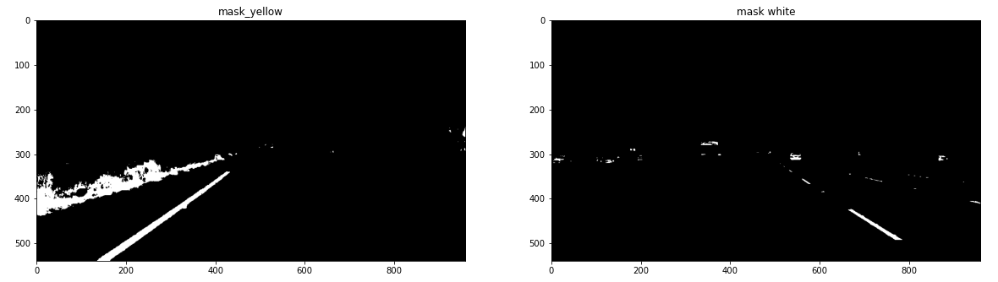
image preprocessing
To extract White color, lower threshold value was (200, 200, 200) (H, S, V) and upper was (255, 255, 255).
mask_white = cv2.inRange(img, (200,200,200), (255, 255, 255))

Slide 15
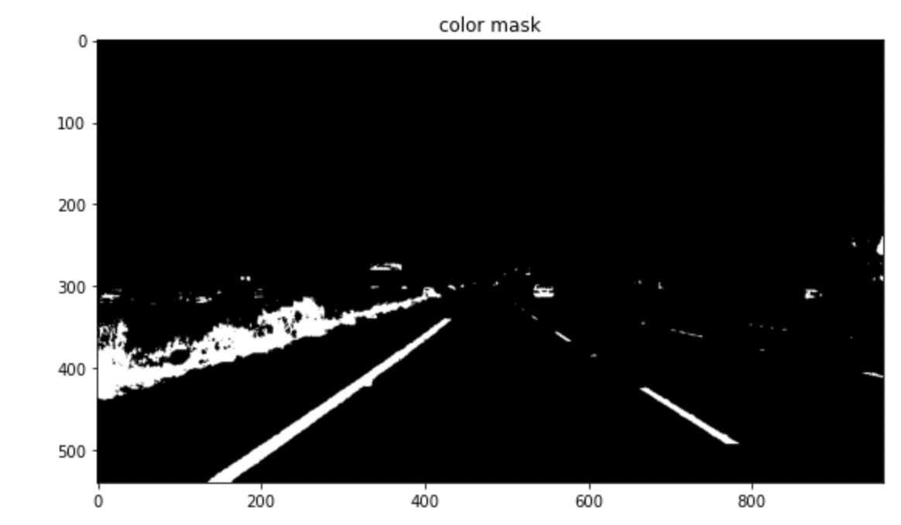
image preprocessing
In order to combine yellow mask & white mask, we applied bitwise OR operator.
color_mask = cv2.bitwise_or(mask_white, mask_yellow)

Slide 16
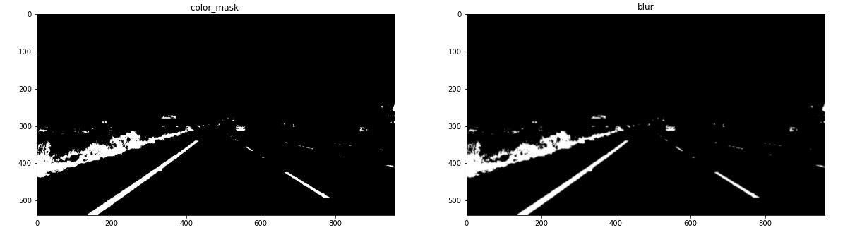
image preprocessing
Gaussian Blur to remove noise or to smooth the image.
To remove many detected edges and only keep the most prominent edges from the image.
blur = cv2.GaussianBlur(color_mask, (5,5), 0)

Slide 17
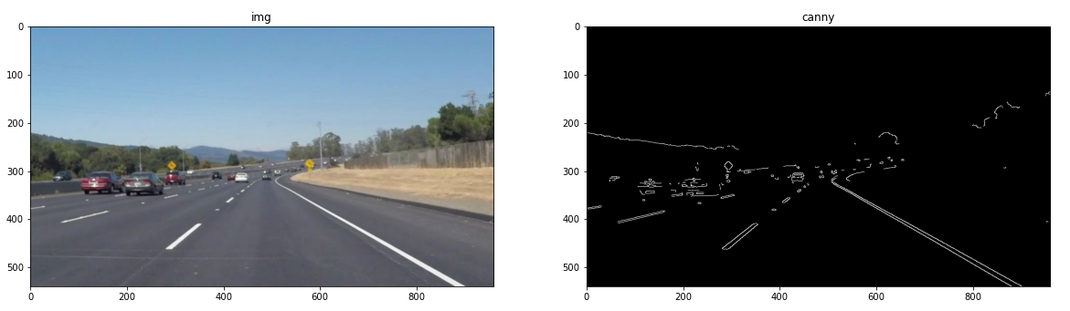
edge detection
cv2.Canny(gray, 200, 300)
Edge detection is applied to extract lane lines boundaries from the image.
There were many edge detection algorithms such as Roberts, Prewitt, Sobel, Canny.

Slide 18
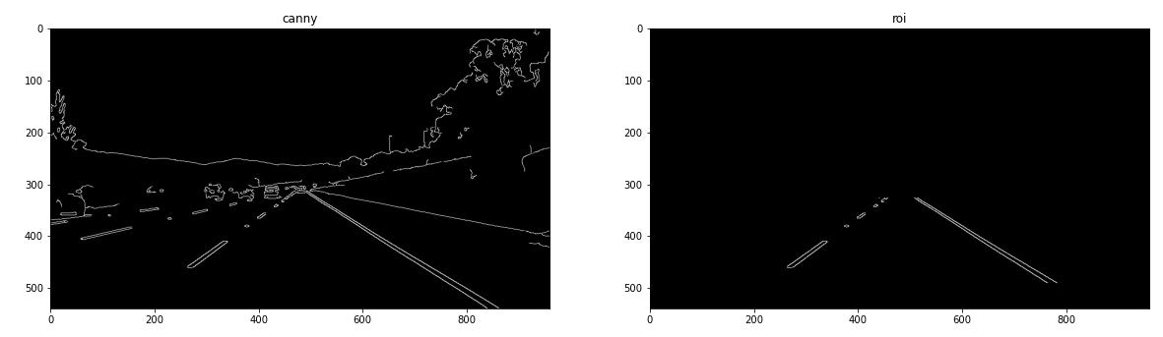
Region of Interest
Define a polygon with coordinates, polygon covers the bottom left and bottom right points of the image. The other two points, it forms a trapezoid that points towards the center of the image.
roi_img = roi(canny_img, coordinates)

Slide 19

Hough Transform
TODO

Slide 20
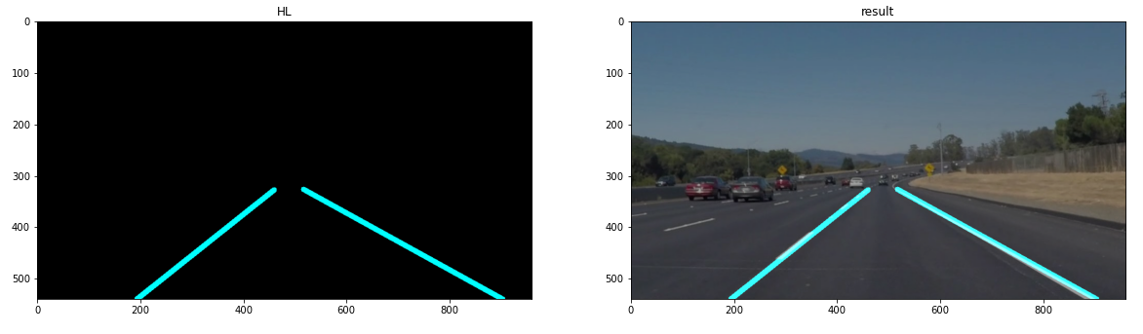
Result (Frame)
Linear Blending: Add Lines on top of the original image using cv2.addWeighted()
cv2.addWeighted(original_img, 0.8, Lines, 1.0, 0.0)

Slide 21
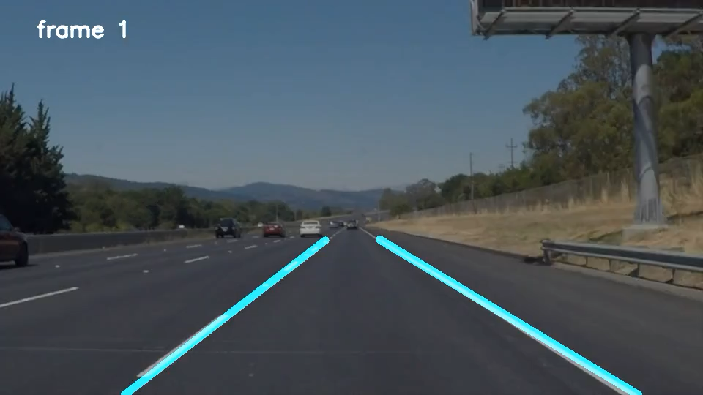
Result (video)

Slide 22
End (maybe)
THANK YOU

